Slide 1



Cloud–Service Models Iaas, Paas, SaaS
By Gowtham raj k.r

Slide 2
Agenda
Introduction To Cloud Computing.
Comparing On-Premises, IaaS, PaaS and SaaS Models.
Why We Need Cloud Service Delivery Models.
IaaS And Why We Need IaaS.
PaaS And Why We Need PaaS.
SaaS And Why We Need SaaS.

Slide 3
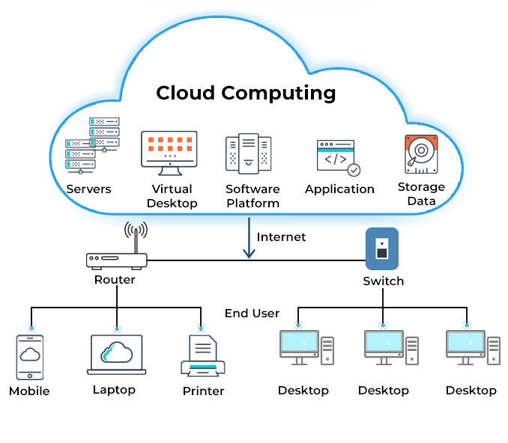
Introduction To Cloud Computing
What is Cloud Computing?
Cloud computing is the on-demand delivery of IT resources over the Internet with pay-as-you-go pricing.
Instead of buying, owning, and maintaining physical data centers and servers, we can access technology services, such as computing power, storage, and databases, on an as-needed basis from a cloud provider like AWS, Microsoft Azure, GCP.

Slide 4
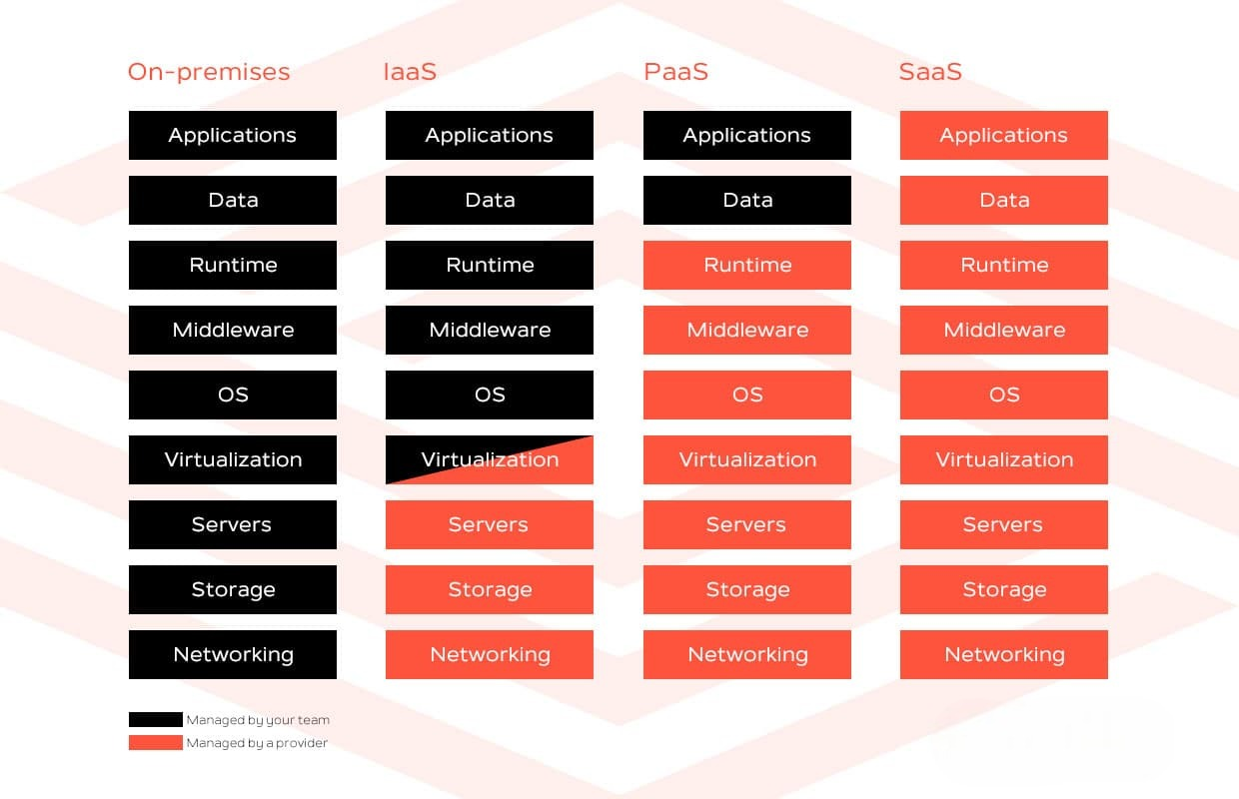
Comparing On-Premises, IaaS, PaaS And SaaS Models

Slide 5
Why We Need Cloud Service Delivery Models
There is no one-size-fits-all cloud service model for every business. The right choice will depend mainly on how many layers companies want to outsource to their service provider when migrating from an on-premises to a cloud solution.
Besides, companies can combine different cloud service models for different purposes.

Slide 6
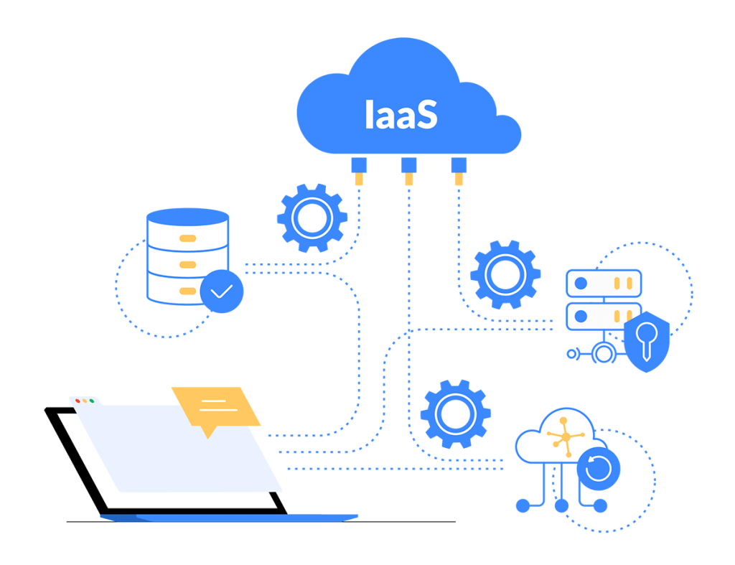
IaaS (Infrastructure as a Service)
IaaS is a cloud service model that consists of provisioning and managing computing resources over the Internet, such as servers, storage, networking and virtualization.

Slide 7
Why We Need IaaS Model
Infrastructure as a Service provides businesses with the technology and capabilities of high-standard data centers.
This way, companies delegate the cost and complexity of building and managing physical servers.
Companies access their infrastructure via a dashboard or API, but they do not have to physically manage it.
This cloud service model offers a lot of flexibility to companies. They can purchase computing resources on-demand, boosting efficiency and scalability.

Slide 8
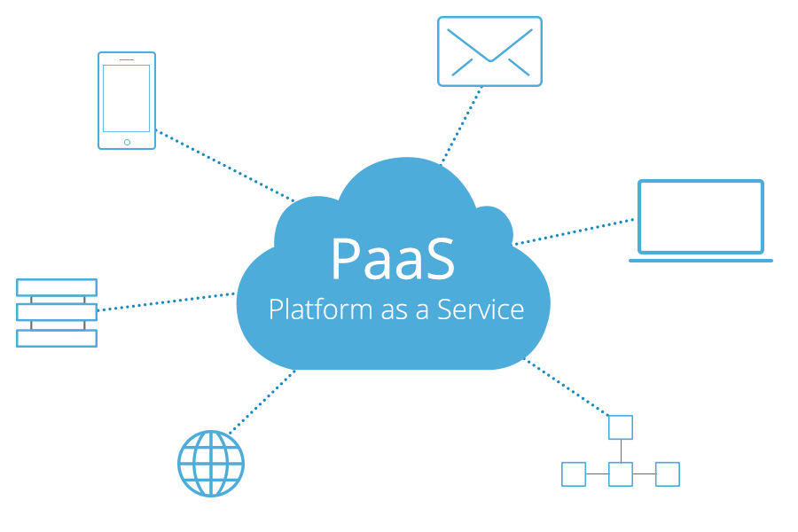
PaaS (Platform as a Service)
PaaS is a cloud service model that provides a ready-to-use development environment where developers can focus on writing and executing high-quality code in order to create customized applications.

Slide 9
Why We Need paas Model
PaaS helps developers and business users focus on build great apps with clicks & code without having to worry about infrastructure and operating systems.
PaaS provides direct support for business agility by enabling rapid development with faster and more frequent delivery of functionality.
PaaS is accessible to multiple users via the same development application. It integrates web services, database engines, etc., to help developers with app development, testing and deployment.

Slide 10
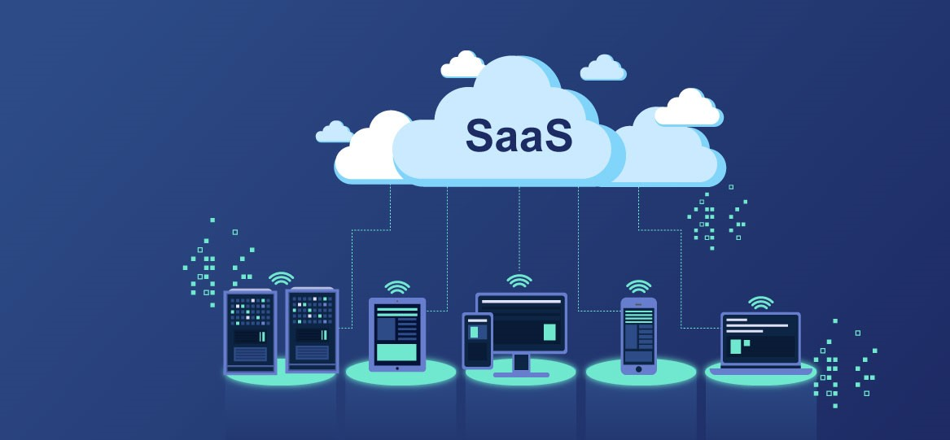
SaaS (Software as a Service)
SaaS is a cloud service model that consists of delivering cloud-based applications to users over the Internet.
Software is hosted online and made available to customers on a subscription basis.

Slide 11
Why We Need saas
SaaS cloud providers host applications in his network and users can access them through a browser or app, from different devices.
SaaS providers are responsible for developing, hosting, maintaining and updating the software.
Therefore, users only need to login and start using it online, without installing or hosting any software locally.
As a result, IT staff do not need to waste time downloading and installing applications on each employee’s computer.

Slide 12


